Slide 1
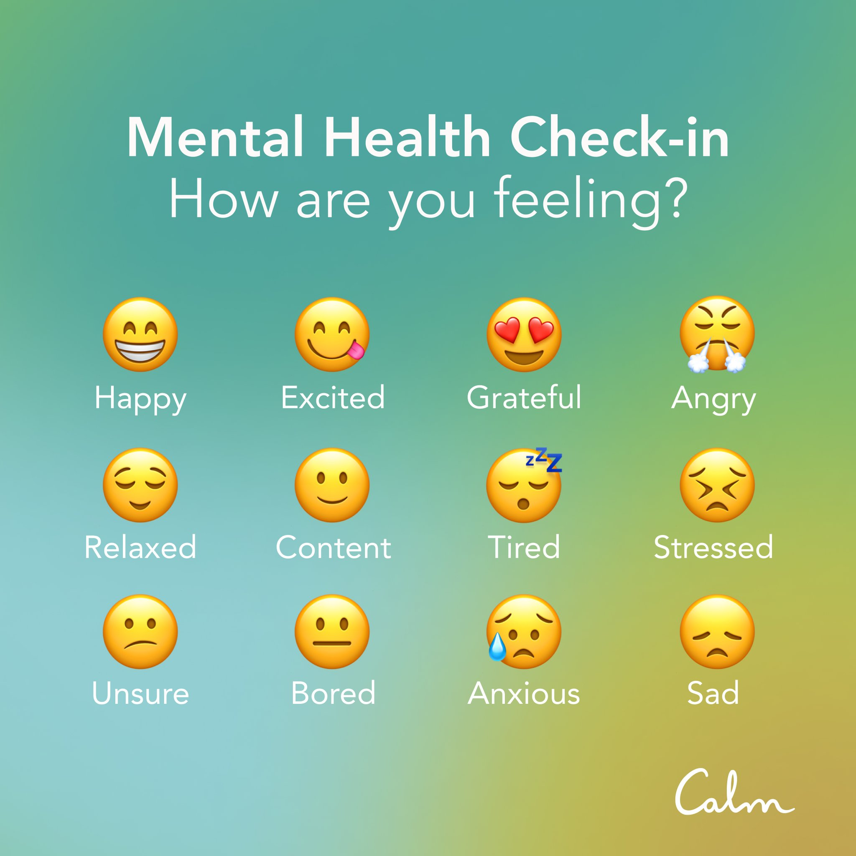

Slide 2
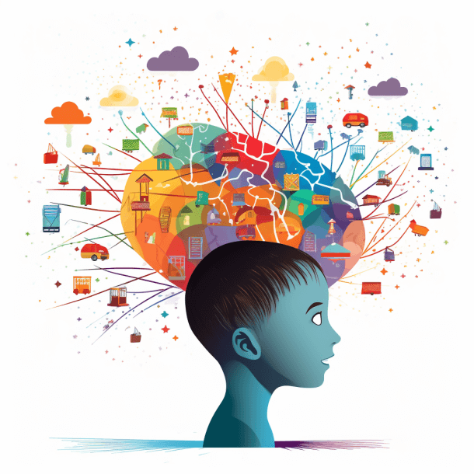
NEURO
DEVELOPMENTAL DISORDERS

Slide 3
Neuro developmental disorders
are a group of disorders that affect the development of nervous system , leading to abnormal brain function which may affect emotion, learning ability, self control and memory. The effects of neurodevelopmental disorders tend to last for a person's lifetime
are conditions that affect how your brain functions. They range from mild impairments, allowing those affected to live fairly normal lives, to severe disorders that require lifelong care

Slide 4
NEURO
DEVELOPMENTAL DISORDERS
Attention Deficit Hyperactivity Disorder (ADHD)
Intellectual disability (ID) or intellectual and developmental disability (IDD), previously called mental retardation
Specific learning disorders.
Autistic spectrum disorders
Stuttering, Selective Mutism, Tic Disorder

Slide 5
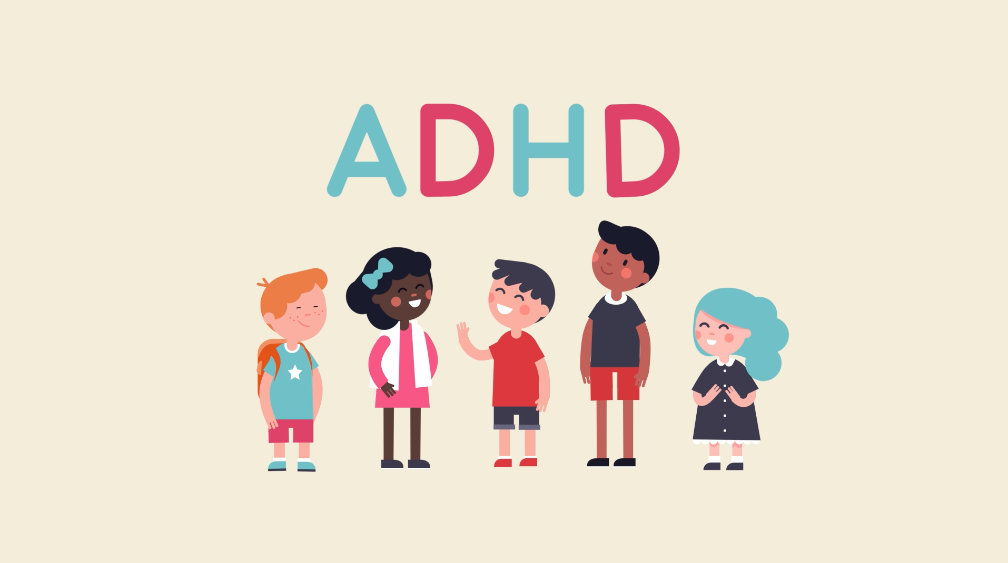

Slide 6
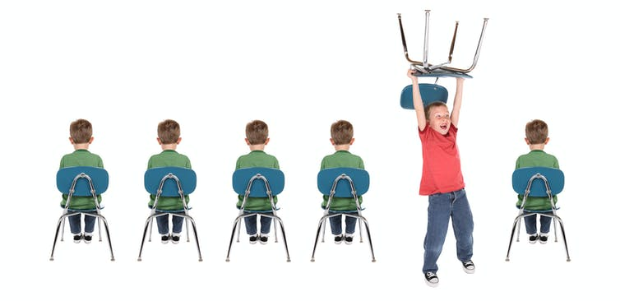
Attention Deficit/ Hyperactivity Disorder or ADHD
A persistent pattern of inattention and/or hyperactivity-impulsivity that interferes with
functioning or development, as characterized by innatention and/or hyperactivity and impulsivity

Slide 7
Diagnostic Criteria
persistent pattern of inattention and/or hyperactivity-impulsivity that persist at least 6 months and for adults age 17 above at least 5 symptoms required are met
1.(Inattention)
2.hyperactivity and impusivity

Slide 8
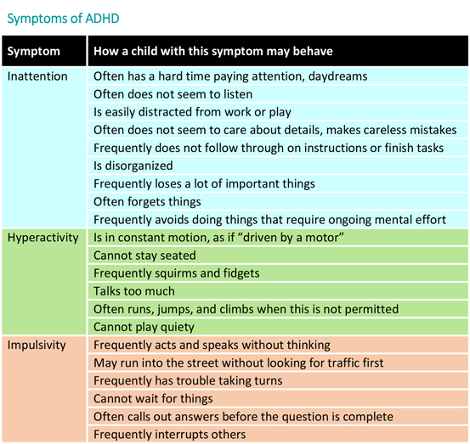

Slide 9
causes
While the exact cause of ADHD is not clear, research efforts continue. Factors that may be involved in the development of ADHD include genetics, the environment or problems with the central nervous system at key moments in development.
Blood relatives, such as a parent or sibling, with ADHD or another mental health disorder
Exposure to environmental toxins — such as lead, found mainly in paint and pipes in older buildings
Maternal drug use, alcohol use or smoking during pregnancy
Premature birth

Slide 10
comorbidity
Mild delays in language, motor, or social development are not specific to ADHD but often co occur
low frustration tolerance, irritability, or mood ability.
oppositional defiant disorder
Conduct disorder
Most children and adolescents with disruptive mood dysregulation disorder have symptoms that also meet criteria for ADHD
disruptive mood dysregulation disorder
Specific learning disorder commonly co-occurs with ADHD
major depressive disorder
Intermittent explosive disorder

Slide 11
Treatment
Behavior therapy
Behavioral therapy is an umbrella term for types of therapy that treat mental health disorders. This form of therapy seeks to identify and help change potentially self-destructive or unhealthy behaviors. It functions on the idea that all behaviors are learned and that unhealthy behaviors can be changed.
Medication
Adderall XR (amphetamine)
Concerta (methylphenidate)
Dexedrine (amphetamine)
Evekeo (amphetamine)
Focalin XR (dexmethylphenidate)

Slide 12
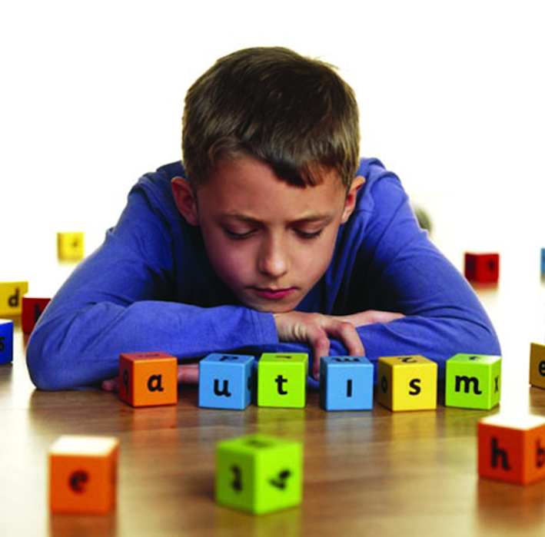
Autism Spectrum Disorder

Slide 13
Pervasive developmental disorder
Autistic disorder – autism refers to a condition where somebody might be removed from social interaction in communication leaving them alone or isolation
Asperger’s disorder- was used for children that appeared to have characteristics of autism, like difficulties with social interactions or nonverbal communication.
Childhood disintegrative disorder was used to describe late onset of developmental delays so these children developed normally for their age.

Slide 14
Clinical Description
Autism Spectrum Disorder (ASD) is a neurological and developmental disorder that begins early in childhood and lasts throughout a person's life. It affects how a person acts and communicates, learns and interacts with others.

Slide 15

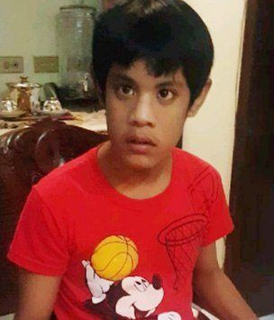
Quentin Pangilinan

Slide 16
Causal factor
Causes: Biological Dimensions
Genetic affect brain development specially areas that affects social and communication behaviors
Numerous genes on a number of our chromosomes have already been implicated in some way in the presentation of ASD and as with other psychological disorders.
Research on children with ASD found lower levels of oxytocin in their blood, and giving oxytocin to people with ASD improved their ability to remember and process information with emotion content

Slide 17
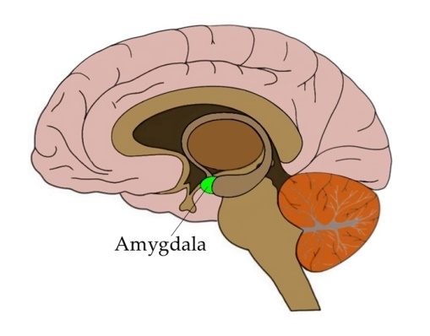
Neurobiological Influences
Research showed that young children with ASD actually have a larger amygdala.
The amygdala in children with ASD is enlarged early in life—causing excessive anxiety and fear (perhaps contributing to their social withdrawal).

Slide 18
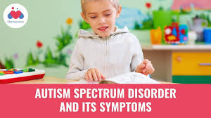
diagnostic criteria

Slide 19
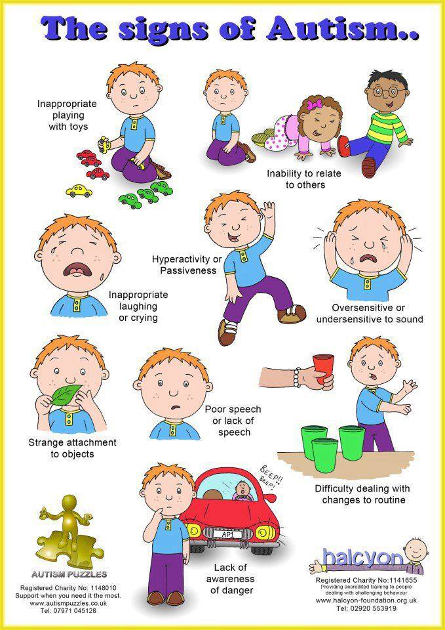

Slide 20

diagnostic criteria
Two major characteristics of ASD are expressed in DSM-5:
1) impairments in social communication and social interaction
2) restricted, repetitive patterns of behavior, interests, or activities

Slide 21

1) impairments in social communication and social interaction
Social emotional reciprocity
Reduced sharing of interest and emotion
Deficits in nonverbal communication used for social interaction
Problems maintaining social relationships.

Slide 22

restricted, repetitive patterns of behavior, interests, or activities
people with ASD spend countless hours in stereotyped and ritualistic behaviors
lining up toys in a ritualistic sort of way
flapping ones hands
imitating words or phrases
might be fixed on certain routines

Slide 23

why some people develop autism and others don’t
risk factors may include:
A sibling with autism
Certain genetic conditions, such as Down, fragile X, and Rett syndromes
Very low birth weight
Older parents

Slide 24
three levels of severity
Level 1— “Requiring support”
Might speak in full sentences
Level 2— “Requiring substantial support”
Difficulty in back-and-fourt Conversation
Level 3— “Requiring very substantial support”.
Rarely interact with others
Extremely resistant to change

Slide 25
comorbidity
frequently associated with intellectual impairment and structural language disorder.
Many individuals with autism spectrum disorder have psychiatric symptoms that do not form part of the diagnostic criteria for the disorder (about 70% of individuals with autism spectrum disorder may have one comorbid mental disorder, and 40% may have two or more comorbid mental disorders).

Slide 26
The types of treatments generally can be broken down into the following categories:
Behavior and Communication Approaches
focus on skill building and behavioral treatment of problem behaviors.
naturalistic teaching strategies
arranging the environment so that the child initiates an interest
increase a variety of social communication skills
e.g., making requests, interactions with peers, joint attention skills, play skills
teach social skills
for example, how to carry on a conversation and ask questions

Slide 27
Behavioral approaches have been most clearly documented as benefiting children in this area.
Pharmacological treatments can help some of them temporarily.
Parents also need support because of the great demands and stressors involved in living with and caring for such children.

Slide 28
Specific Learning Disorder

Slide 29
Clinical Description
Specific Learning Disorder
DSM 5 define it as a set of disorders that relate to having difficulties in learning and developing certain skills for at least 6 months.
They may have difficulty in reading, writing spelling, reasoning and organizing information

Slide 30
Epidemiology
Acc. to DSM 5 Specific Learning Disorder
5-15% among school-age children across different languages and cultures are diagnosed having learning disability.
Prevalence in adults is unknown, but appears to be approximately 4%
Learning disorders are usually diagnosed during the school-aged years.

Slide 31
Four Causal factor
Brain damage
Heredity
Biochemical imbalance
Environmental Factor

Slide 32
Diagnostic Criteria
1. Inaccurate or slow and effortful word reading
2. Difficulty understanding the meaning of what is read
3. Difficulties with spelling
4. Difficulties with written expression
5. Difficulties mastering number sense, number facts, or calculation
6. Difficulties with mathematical reasoning

Slide 33

Dyslexia
difficulty with reading
difficulty understanding the meaning of what is read

Slide 34
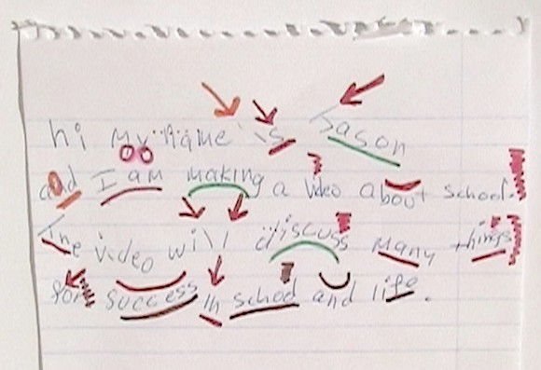
Dysgraphia
difficulty with writing and written expression

Slide 35


Dyscalculia
difficulty with mathematics
difficulties mastering number sense, number facts, or calculation
difficulties with mathematical reasoning

Slide 36
Severity of Disorder
Mild: Some difficulties learning skills in one or two academic domains
Moderate: Marked difficulties learning skills in one or more academic domains
Severe: Severe difficulties learning skills, affecting several academic domains

Slide 37
Comorbidity
National Institute of Mental Health and Neurosciences, Bengaluru; Muthukumar et al.mfound that
79% of children with learning disabilities had comorbid psychological disorders, in which
32% had internalizing disorders,
28% had externalizing disorders and
19% had other disorders.

Slide 38
Treatment
As you will see in the case of intellectual disability, learning disorders primarily require educational intervention
Educational efforts
(1) specific skills instruction, including instruction on vocabulary, finding the main idea, and finding facts in readings, and
(2) strategy instruction, which includes efforts to improve cognitive skills through decision making and critical thinking.

Slide 39

INTELLECTUAL DISABILITY
(Intellectual developmental Disorder)
- Involves problems with general mental abilities that affect functioning in two areas:
Intellectual Functioning
Adaptive Functioning
INTELLECTUALFUNCTIONING ( INTELLIGENCE)
Such as learning, reasoning, and problem solving.

Slide 40
DIAGNOSTIC CRITERIA OF INTELLECTUAL DISABILITY
Deficits in intellectual functioning - reasoning, problem solving, planning, abstract thinking, judgment, academic learning, and learning from experience”
Deficits in Adaptive functioning that significantly hamper conforming to developmental and sociocultural standards for the individual's independence and ability to meet their social responsibility
The onset of these deficits during childhood

Slide 41
ADAPTIVE FUNCTIONING
CONCEPTUAL SOCIAL PRACTICAL SKILLS
-Language -Communication -Job Responsibilities
-Reading, writing -Follow Rules -Managing mone
-memory, knowledge -Make friendship -Organizing school and work task

Slide 42
POSSIBLE TREATMENT
-Different types of supports and services can help such as:
Early Intervention
Special education
Family support
Vocational Program

Slide 43
COMMUNICATION DISORDER
Characterized by Impairment in Sending, receiving processing or comprehending verbal / non verbal that influence the behavior, of another individual.
These disorders can affect hearing, speech, and language, and may be present in various forms, such as speech sound disorders, language disorders, and social (pragmatic) communication disorders

Slide 44
TYPES OF
COMMUNICATION
DISORDER

Slide 45
LANGUAGE DISORDER - Involves the processing of linguistic information and rarely caused by a lack of intelligence
Examples of language disorders include receptive language disorder (difficulty understanding spoken language) and expressive language disorder (difficulty using language to express thoughts and ideas
SPEECH SOUND DISORDER- Involves difficulties in articulation fluency, and voice, difficulty saying words or sounds correctly
Examples include saying "coo" instead of "school" (leaving off sounds), "puhlay" instead of "play" (adding sounds), or "thith" instead of "this" (distorting sounds)

Slide 46
CHILDHOOD ON SET FLUENCY DISORDER
(STUTTERING)
Characterized by a disturbance that income frequent and significant problems with normal fluency and flow of speech.
Examples include repeating sounds or syllables ("b-b-ball"), prolonging sounds ("ssssssnake"), or having blocks or pauses during speech ("I-I-I want to go."). Some individuals also experience secondary behaviors like facial tension or avoidance of certain words.
SOCIAL COMMUNICATION DISORDER (PRAGRAMIC)
Deficits in using communication for social purposes, impairments of the ability to change.

Slide 47
“INTELLECTUAL DISABILITY IS A NEURODEVELOPMENTAL DISORDER NOT A MENTAL ILLNESS”

Slide 48
Childhood-Onset Fluency Disorder (Stuttering)

Slide 49

Description
Childhood-onset fluency disorder, also known as stuttering or stammering is a common disorder.
A multifactorial speech disorder, it is normally seen with recurrent prolongations, reverberations, or blocks of sounds, syllables, phrases or words

Slide 50
Interruptions in normal fluency and time patterning of speech (unsuitable for the individual’s age), exemplified by repeated occurrences of 1 or more of the following:
Sound and syllable repetitions
Sound prolongations
Interjections

Slide 51
Broken words (such as breaks within a word)
Audible or silent blocking (filled or unfilled gaps in speech)
Circumlocutions (word substitutions to evade challenging words)
Words formed with an overload of physical tension
Monosyllabic whole-word repetitions

Slide 52
Causes
Abnormalities in speech motor control. Some evidence indicates that abnormalities in speech motor control, such as timing, sensory and motor coordination, may be involved.
Genetics. Stuttering tends to run in families. It appears that stuttering can result from inherited (genetic) abnormalities.

Slide 53
Delayed childhood development. Children who have developmental delays or other speech problems may be more likely to stutter.
Having relatives who stutter. Stuttering tends to run in families.
Stress. Stress in the family, high parental expectations or other types of pressure can worsen existing stuttering.

Slide 54
Selective Mutism
Selective mutism is a rare and multidimensional childhood disorder that typically affects children entering school age.
It is characterized by the persistent failure to speak in select social settings despite possessing the ability to speak and speak comfortably in more familiar settings. Many theories attempt to explain the etiology of selective mutism

Slide 55
Diagnostic Criteria
Consistent failure to speak in specific social situations (in which there is an expectation for speaking, e.g., at school) despite speaking in other situations.
The disturbance interferes with educational or occupational achievement or with social communication.
The duration of the disturbance is at least 1 month (not limited to the first month of school).

Slide 56
The failure to speak is not due to a lack of knowledge of, or comfort with, the spoken language required in the social situation.
The disturbance is not better accounted for by a Communication Disorder (e.g., stuttering) and does not occur exclusively during a Pervasive Developmental Disorder, Schizophrenia, or other Psychotic Disorder

Slide 57
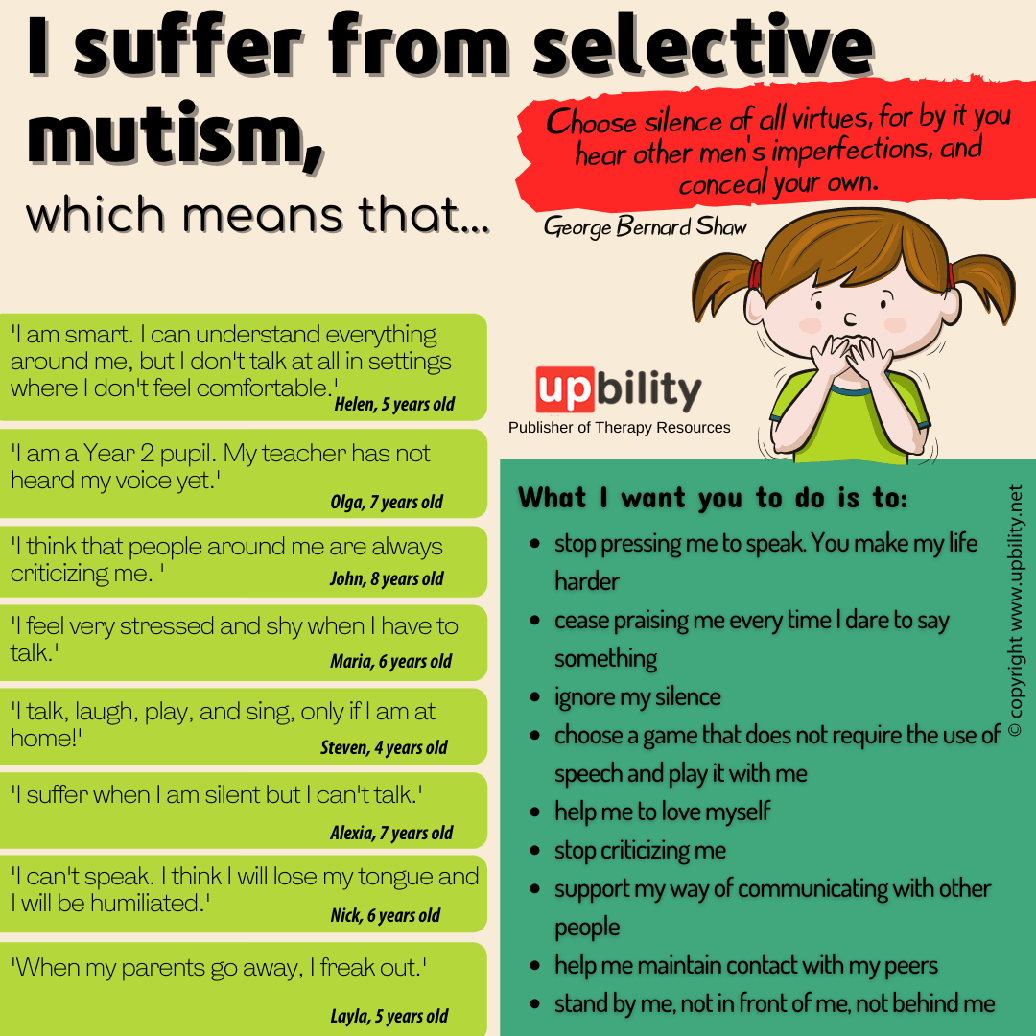

Slide 58
Causes
Experts regard selective mutism as a fear (phobia) of talking to certain people. The cause is not always clear, but it's known to be associated with anxiety.
Many children become too distressed to speak when separated from their parents and transfer this anxiety to the adults who try to settle them.

Slide 59
If they have a speech and language disorder or hearing problem, it can make speaking even more stressful.
Some children have trouble processing sensory information such as loud noise and jostling from crowds – a condition known as sensory integration dysfunction.

Slide 60
comorbidity
psychiatric or language/speech development disorders
enuresis,
encopresis,
obsessive-compulsive disorder,
depression,
premorbid speech and language abnormalities,
developmental delay,
Asperger's disorders

Slide 61
Treatment
Social Communication Anxiety Therapy
Behavioral Therapy
Play Therapy, Psychotherapy, and other psychological approaches
Cognitive Behavioral Therapy
Medication
Self-esteem boosters
Frequent socialization
School involvement
Family involvement and parental acceptance

Slide 62
Tic Disorder

Slide 63
Tic Disorder
Tics are defined as rapid and repetitive muscle contractions resulting in movement or vocalizations that are involuntary.
Four diagnostic Categories
1. Tourette Disorder
2. Persistent ( Chronic ) motor or vocal Tic disorder
3. provisional Tic disorder
4. other specified or unspecified tic disorder

Slide 64
Tourette’s Disorder
Tourette’s Disorder
A. Both multiple motor and one or more vocal tics have been present at some time during the illness, although not necessarily concurrently.
Onset is before age 18 years.
The disturbance is not attributable to the physiological effects of a substance (e.g., cocaine) or another medical condition (e.g., Huntington’s disease, postviral encephalitis).

Slide 65
Persistent (Chronic) Motor or Vocal Tic Disorder
Persistent (Chronic) Motor or Vocal Tic Disorder
A. Single or multiple motor or vocal tics have been present during the illness, but not both motor and vocal.
B. The tics may wax and wane in frequency but have persisted for more than 1 year since first tic onset.
C. Onset is before age 18 years.
D. The disturbance is not attributable to the physiological effects of a substance (e.g., cocaine) or another medical condition (e.g., Huntington’s disease, postviral encephalitis). E. Criteria have never been met for Tourette’s disorder. Specify if: With motor tics only With vocal tic

Slide 66
Provisional Tic Disorder
A. Single or multiple motor and/or vocal tics.
B. The tics have been present for less than 1 year since first tic onset.
C. Onset is before age 18 years.
D. The disturbance is not attributable to the physiological effects of a substance (e.g., cocaine) or another medical condition (e.g., Huntington’s disease, postviral encephalitis). E. Criteria have never been met for Tourette’s disorder or persistent (chronic) motor or vocal tic disorder. Specifiers The “motor tics only” or “vocal tics only” specifier is only required for persistent (chronic) motor or vocal tic disorder.

Slide 67
Simple Tics
Simple tics are quick, sudden, repetitive, and non-rhythmic movements or sounds that involve a few muscle groups. They are more common than complex tics and often precede them.
Examples of simple motor tics include blinking, grimacing, head jerking, and shoulder shrugging,

Slide 68
Causes
There is no known cause of transient tic disorder. Like Tourette syndrome and other tic disorders, a combination of factors influences it.
Some research indicates that tic disorders may be inherited. A genetic mutation can cause Tourette syndrome in rare cases.
Abnormalities in the brain may also be responsible for tic disorders. Such abnormalities are the cause of other mental conditions, such as depression and attention deficit hyperactivity disorder (ADHD).
Some research suggests that transient tic disorder could be linked to neurotransmitters. Neurotransmitters are the chemicals in the brain that transmit nerve signals to your cells. However, no studies offer complete proof of the role neurotransmitters play. Medications to treat transient tic disorder alter neurotransmitter levels.

Slide 69
Comorbidity

